Slide 1
Molecule only prediction
Notes:
What this is:

Slide 2
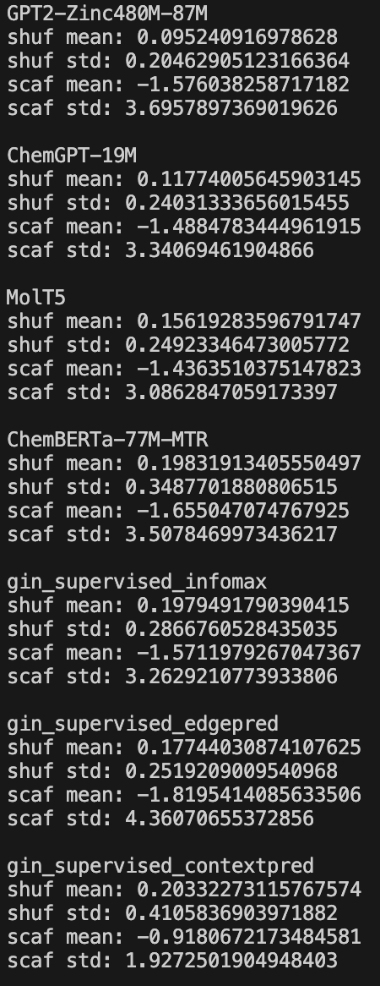
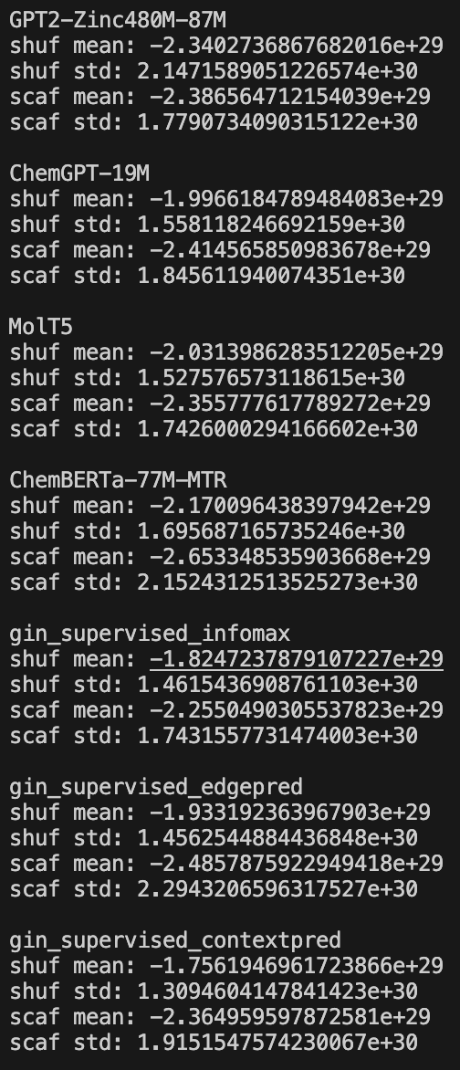
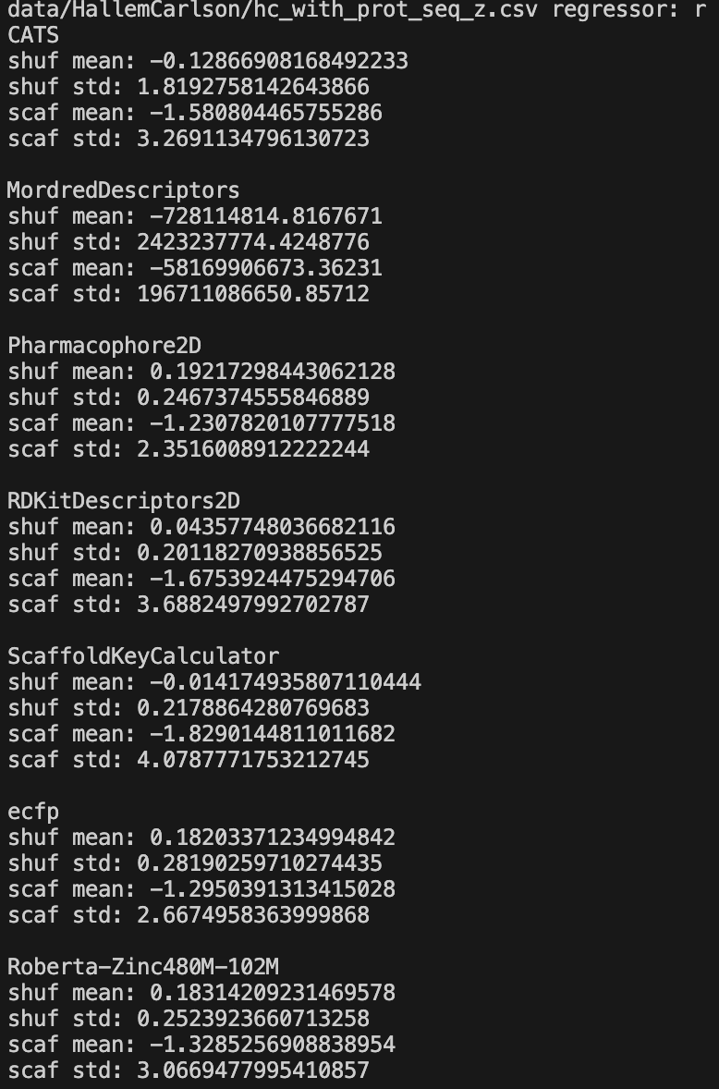
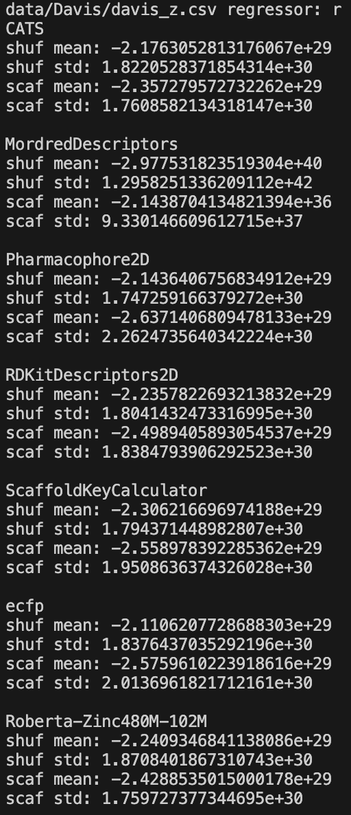
Hallem Carlson
Davis

Slide 3
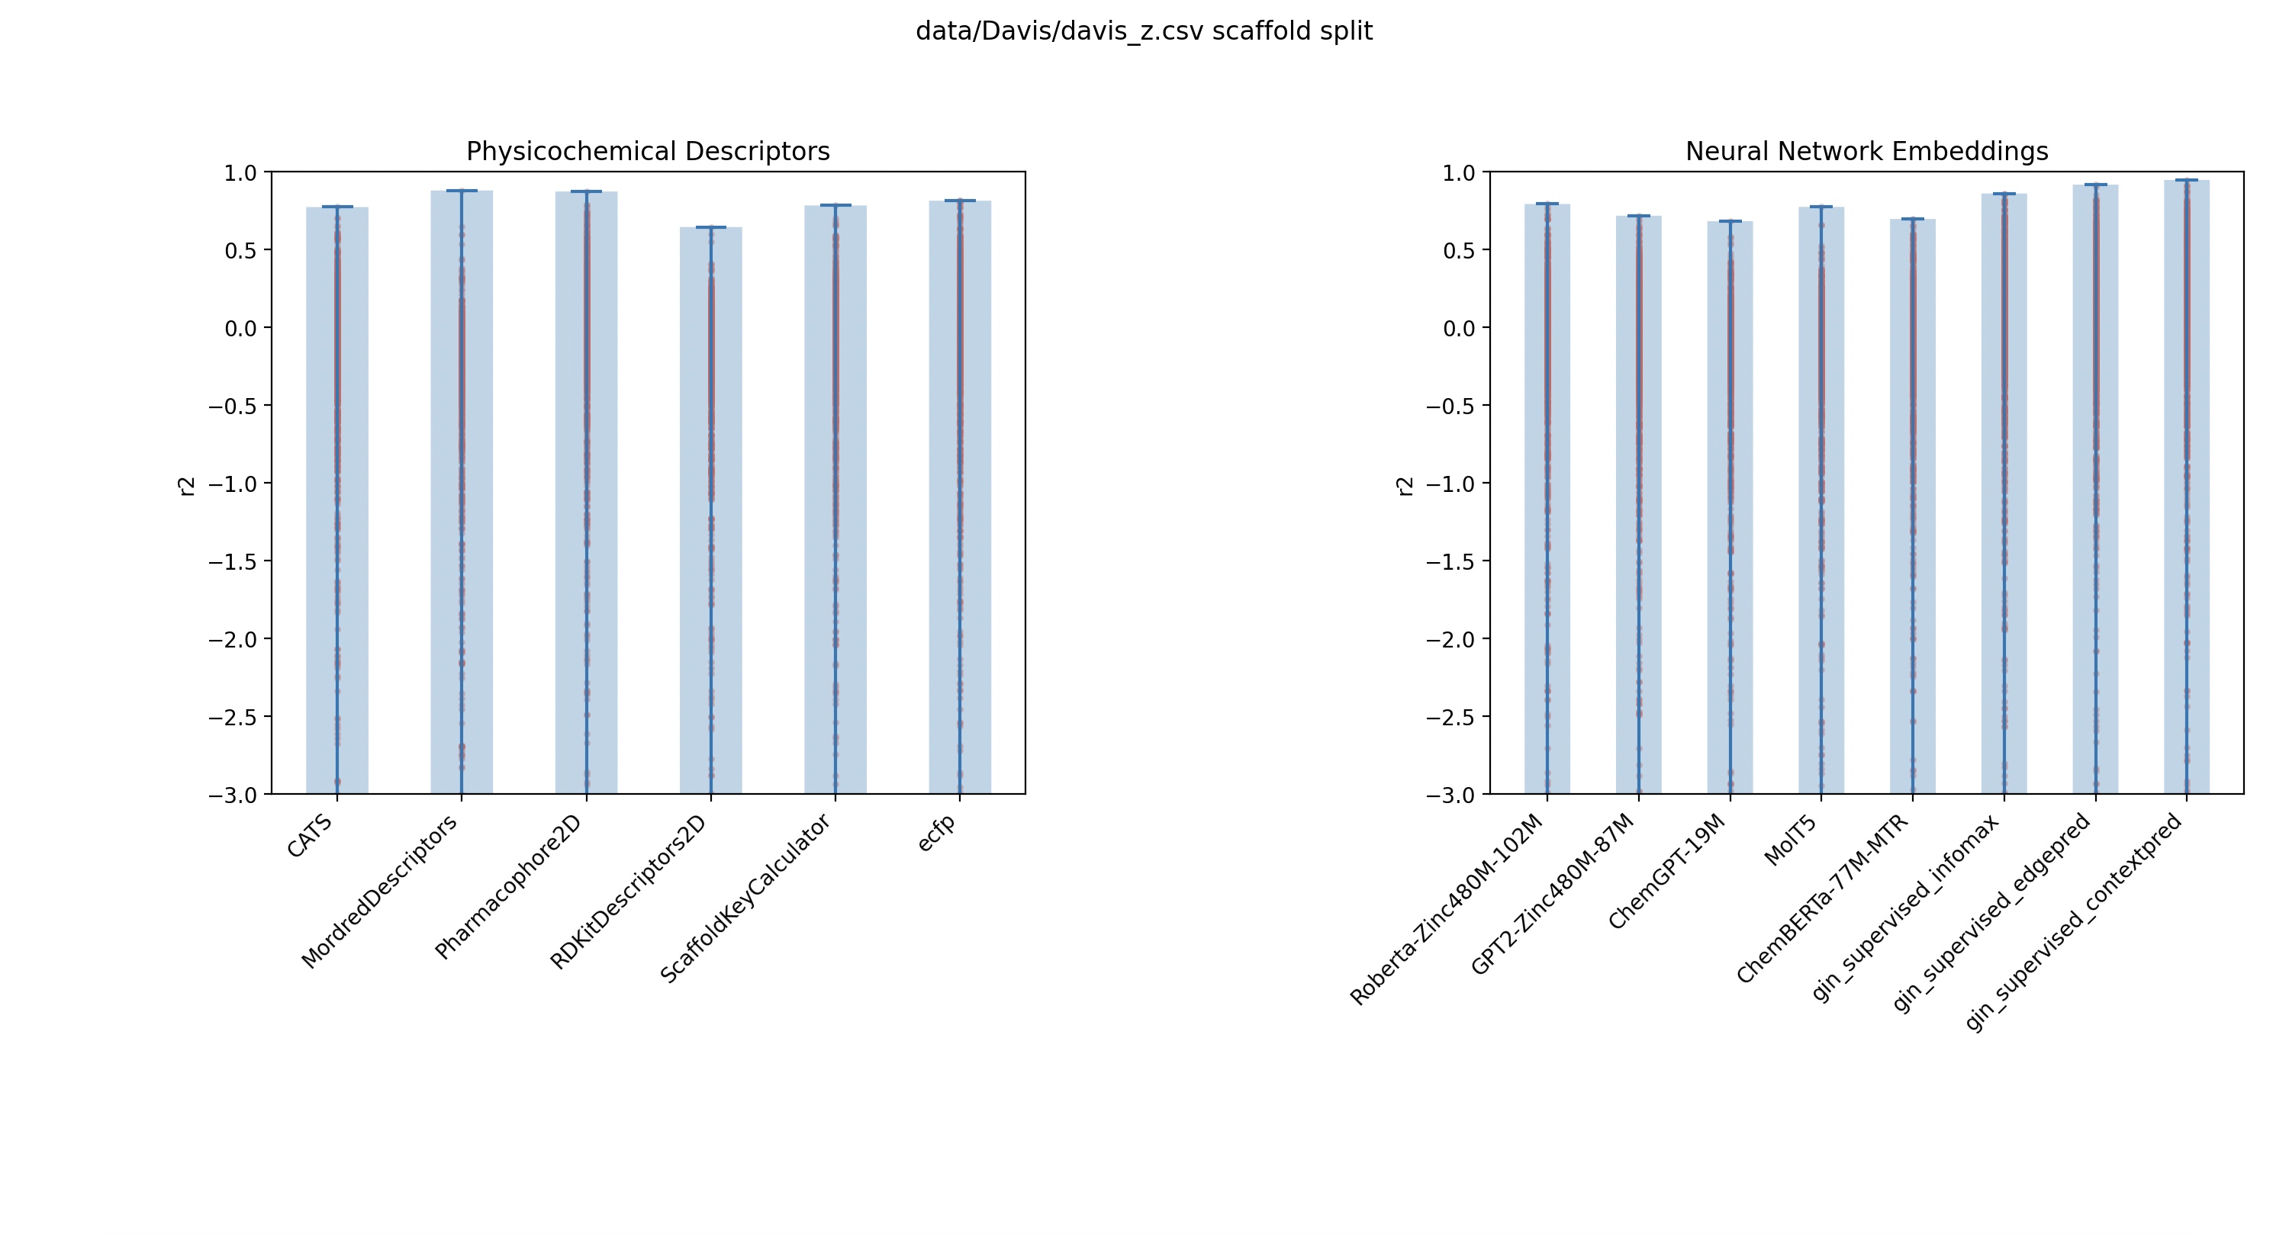
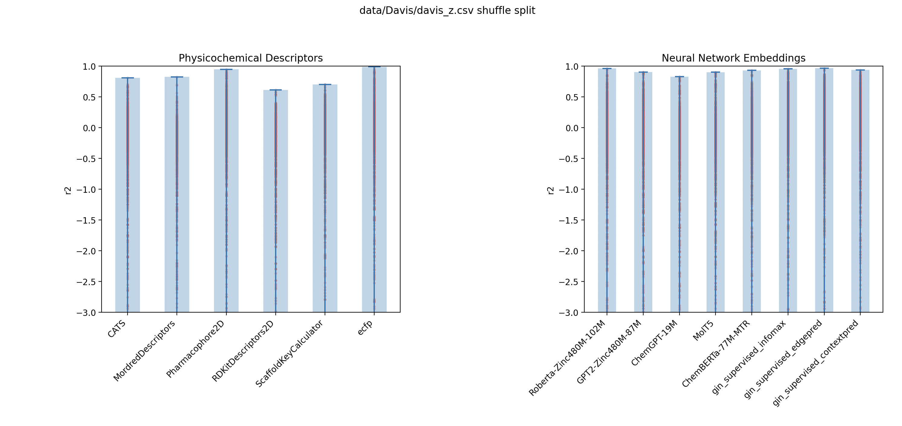

Slide 4
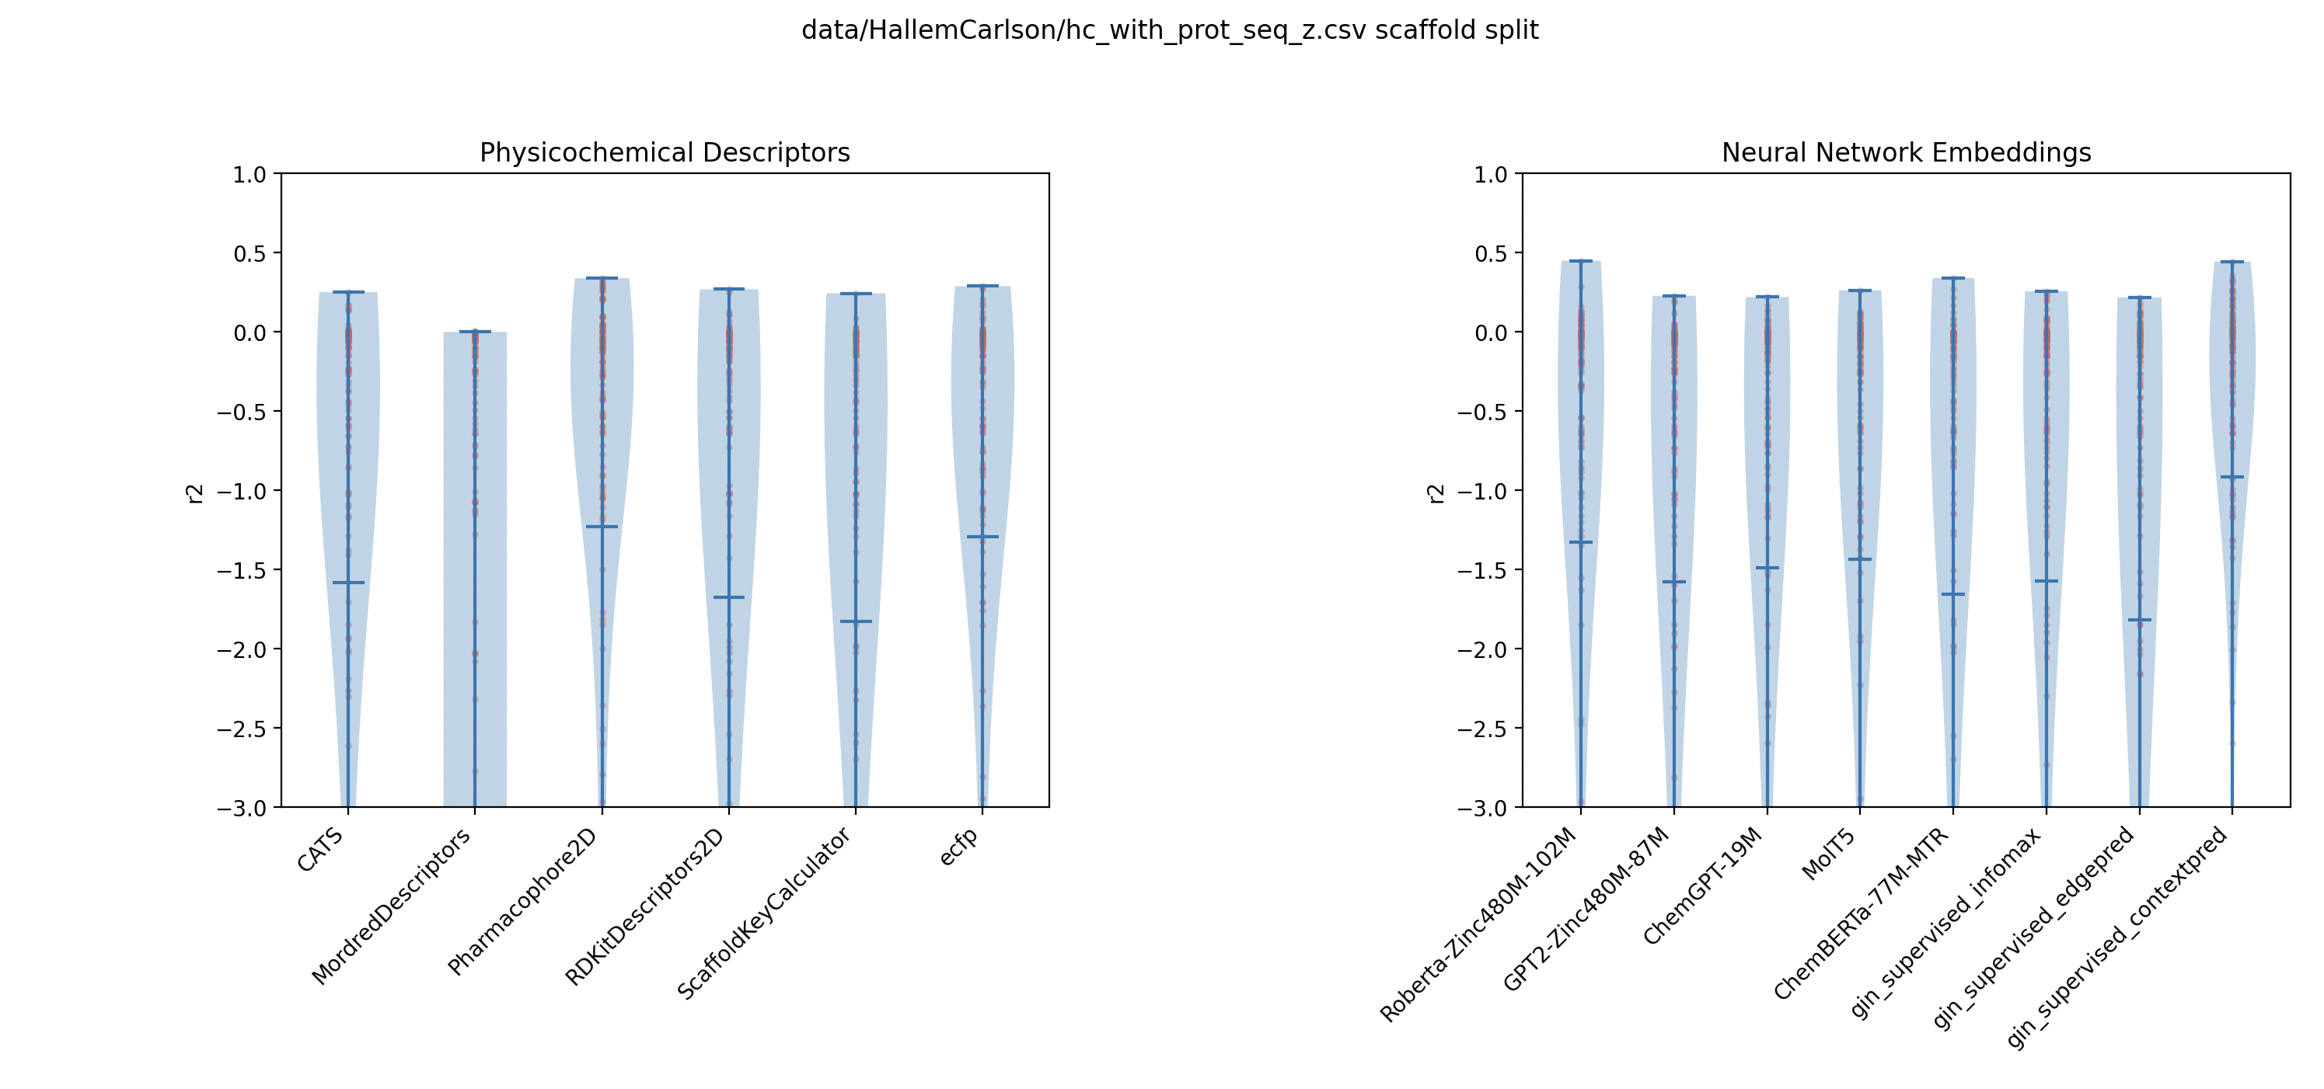
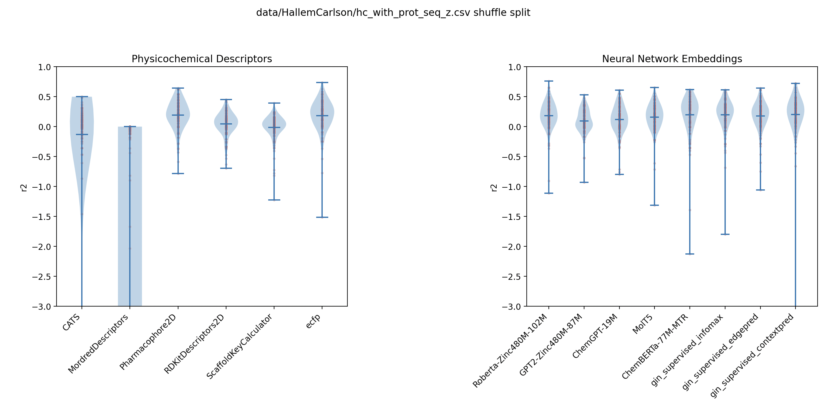

Slide 5
Mol-Protein Embedding (Grant-smith)

Slide 6
Random Split

Slide 7
CD-hit Split

Slide 8
Prosmith Datasets individually

